Slide 1
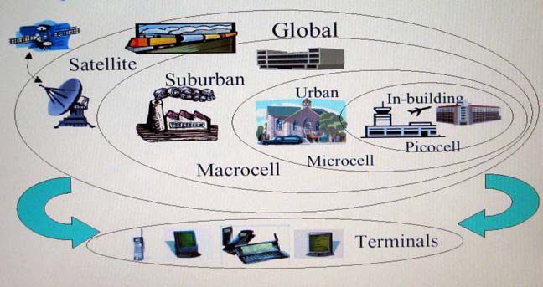
Interest of wireless communications
A single handset to support all wireless environments:
Seamless Communications

Slide 7
Evolution of semiconductor technology

Slide 8
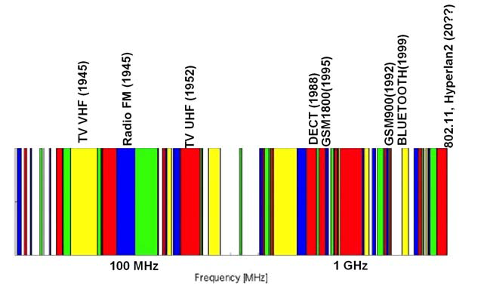
Evolution of semiconductor technology
Impact on frequency occupation (i):

Slide 9
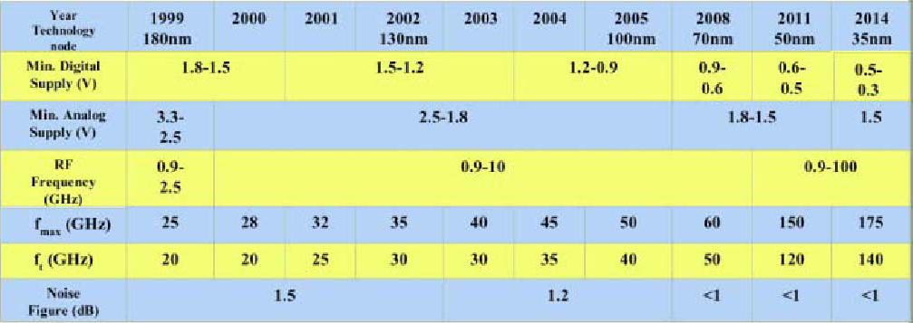
Evolution of semiconductor technology
fwork < fT/5 (aprox.)

